Slide 1

Integrated Regional Water Management Disadvantaged Community Involvement Program (DACIP)
Department of Water Resources
Tulare-Kern Funding Area
Disadvantaged Community Engagement & Education Program (DACEEP) Vision Workshop
January 16, 2020
Prepared for the Tulare-Kern Funding Area
Project Advisory Committee (PAC)
Paul Boyer, Sonia Sanchez, Seamus Guerin
Self-Help Enterprises

Slide 2
DACEEP Objective
Develop a “Regional Involvement Program” that builds understanding of community water needs and IRWM process
Encourage DAC participation and engagement in IRWM activities
Total Allocated Budget for Program: $550,000

Slide 3
Tulare-Kern DACIP
DACEEP Past and Present Approval Process
Phase 1:
Evaluate Present DAC Engagement in IRWM Activities & Develop Educational Tools
August 2018
Phase 1 Amendment:
Continue Evaluation of DAC Engagement & Begin Additional Program Activities
October 2018
Phase 2:
Additional Program Activities to Improve & Sustain DAC Engagement
January 2020

Slide 4
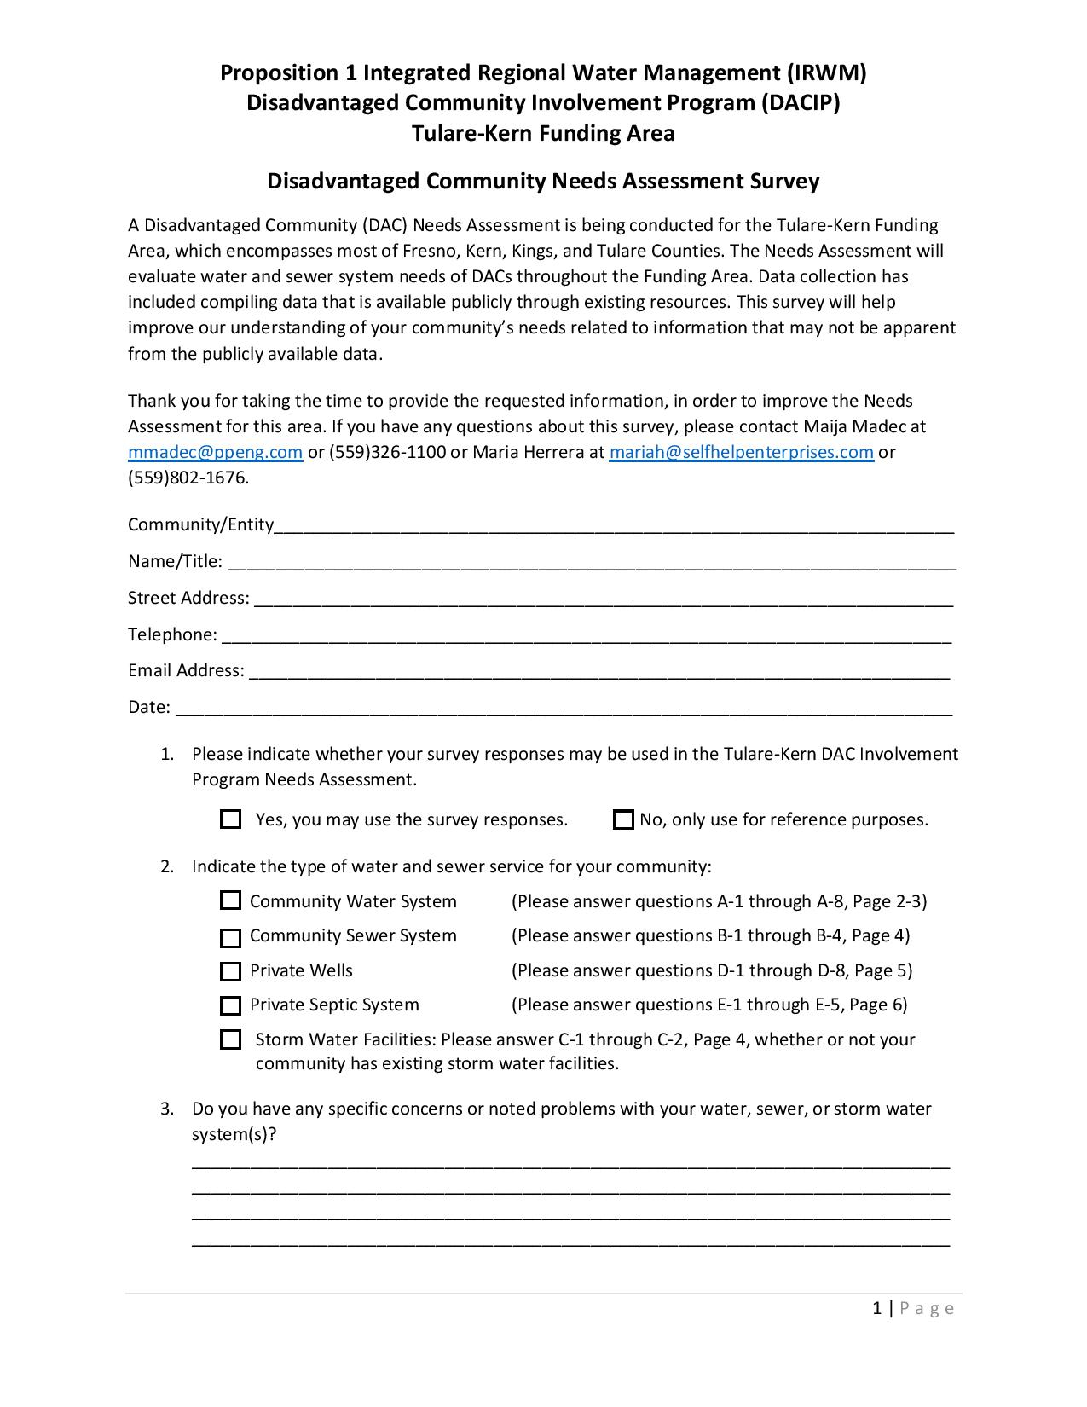
Phase 1 & Phase 1 Amendment Key Accomplishments
Developed and Released DAC IRWM Participation Survey
Developed and Released Community Needs Assessment Survey
Held Four (4) Workshops
  Kings Basin Water Authority IRWM/Westside San Joaquin IRWM: Selma
  Kern County IRWM: Bakersfield
  Southern Sierra IRWM: Squaw Valley
  Poso Creek IRWM: Wasco

Slide 5
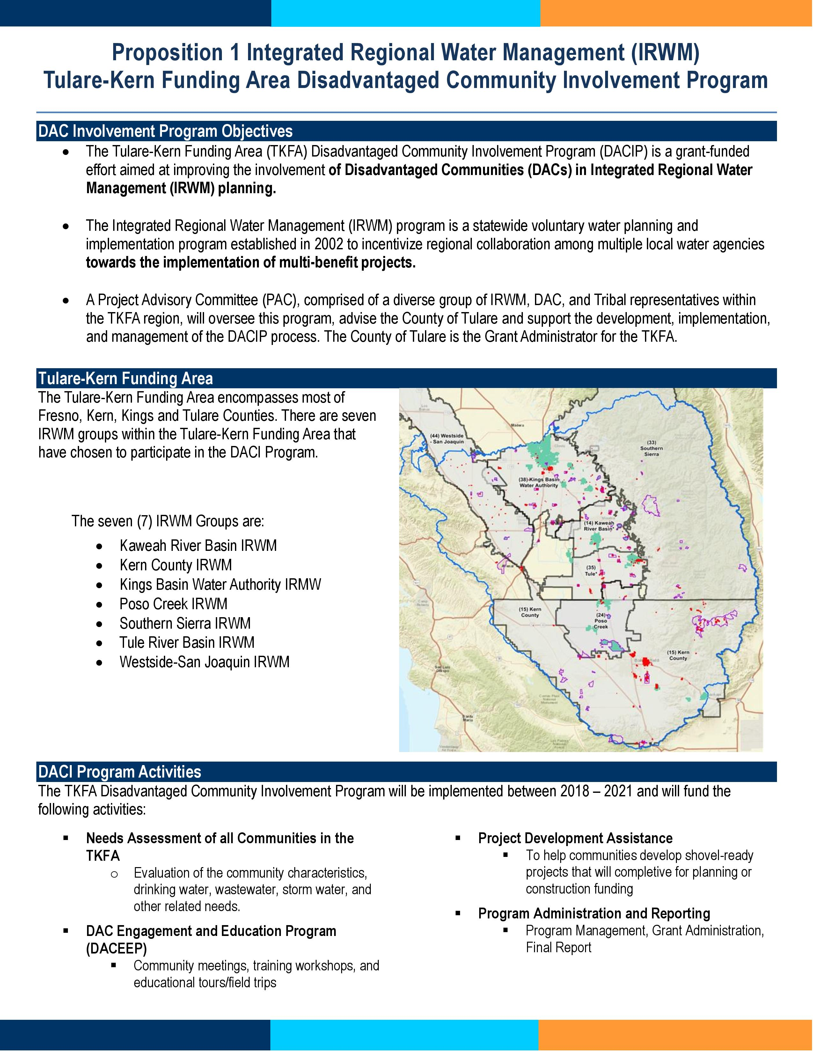
Phase 1 & Phase 1 Amendment Key Accomplishments
Assisted Several DACs in obtaining Project Development Funding
Submitted Combined Total of Twelve (12) DAC Project Information Forms & Project Information Forms
Developed Bilingual (English and Spanish) Educational Documents
  Get to Know Your IRWM Factsheets
  TKFA DACIP Informational Sheet
Reconvened White Areas Working Group
Selected Communities to Conduct Septic System Surveys

Slide 6
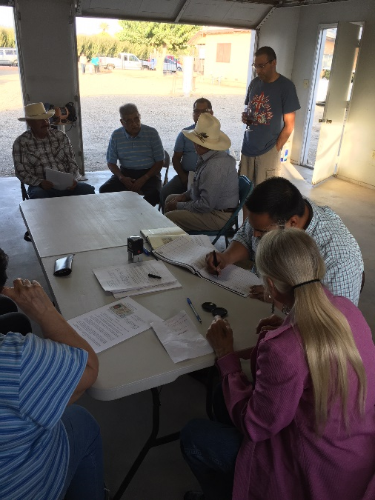
DACEEP Phase 2 Proposal Presentation Objectives
Assessment of Present DAC Engagement in IRWM
  Review DAC Updated Participation Summary, Survey Responses, Summarize Findings and Develop Recommendations
  Incorporate Feedback Provided by the IRWM Regions
  Prepare DAC Outreach and Engagement Recommendations Report
Community Water Needs Assessment
  Review Community Needs Assessment Survey Responses and Prepare Draft and Final Summary Reports
  Conduct Surveys and Collect Information on Communities Relying on Individual Septic Systems
    Five Points, Fresno County
    Allensworth, Tulare County
    Hardwick, Kings County
    Athal, Doney Street, Choate Street and Mettler, Kern County

Slide 7
DACEEP Phase 2 Proposal Presentation Objectives
Community and Tribal Engagement Outreach
  Develop outreach plan and conduct community outreach
  Work with Civic Sparks, Tulare County and other relevant stakeholders (e.g. IRWM representatives, DWR’s Tribal Liaison, others) to develop a Tribal engagement plan
Conduct Regional Community Meetings and Tribal Consultations to ground truth Needs Assessment
  Facilitate Community Meetings and Tribal Consultations
Funding Area Bilingual (English and Spanish) Communication and Educational Tools
  Develop messaging memo, finalize case studies and develop bilingual educational video series

Slide 8
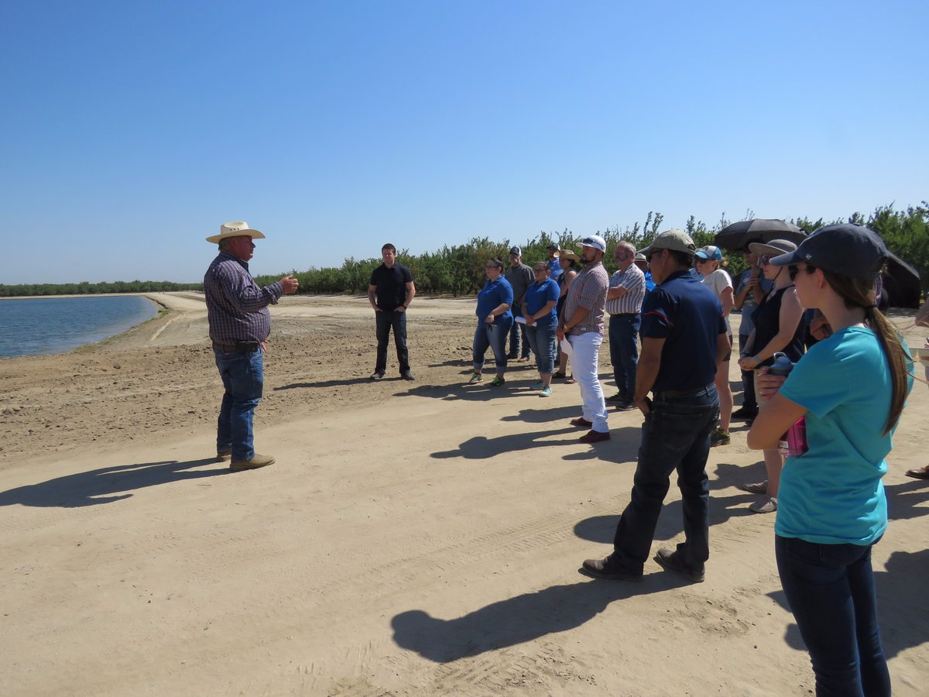
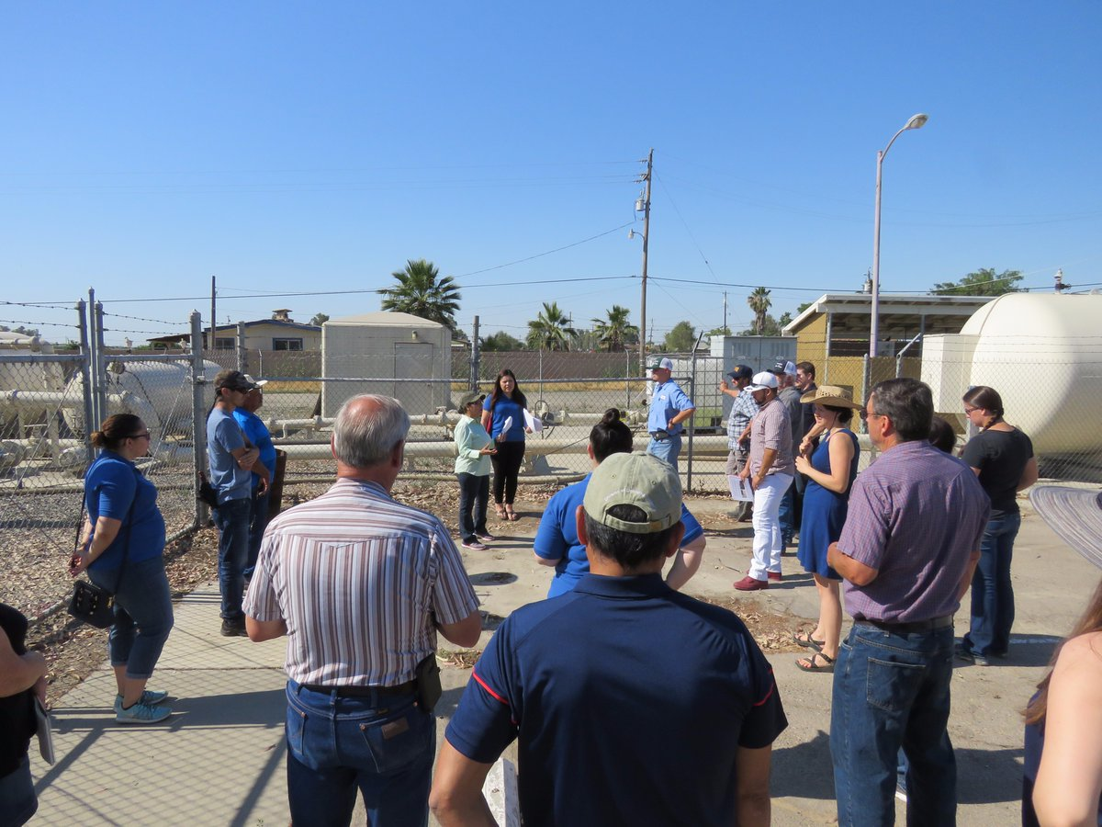
DACEEP Phase 2 Proposal Presentation Objectives
Educational Water Management Tours
  Up to two (2) educational tours focused on integrated water management, including water sources, uses, users, movement of water and challenges and how the IRWM program work and examples of successful projects
TKDACI Roadshow
  Work with County of Tulare to conduct at least one and up to two County Board of Supervisors presentations in each participating county (Fresno, Kings and Kern).
  Will include an overview of the TKDACI program, Needs Assessment, and a demonstration of the Community Water Assessment Tool

Slide 9
DACEEP Phase 2 Proposal Presentation Objectives
Develop Individual DAC Engagement and Outreach Recommendations for IRWM Regions
  Tailored DAC Engagement and Outreach Recommendations for Each of the Seven IRWM Regions
Develop IRWM Participation Recommendations for DACs and SDACs that are Outside an IRWM Region
  Develop outreach summary and recommendations
Technical Assistance
  Assist DACs to complete project information forms and get their project(s) on an IRWM list
  Attend IRWM Meetings/Tulare Basin IRWM coordination meetings

Slide 10
DACEEP Phase 2 Proposal Presentation Objectives
Conduct Pre-Application and Grant Application Workshops or Trainings
  Conduct up to two pre-application and grant application workshops/trainings prior to the Prop 1 IRWM Round 2 solicitation
  Facilitate DAC participation at DWR meetings/workshops within the funding area
TKFA Activities
  Update DAC Contact List for Each IRWM Region
  Assist with Identifying DAC and Tribal Leaders to Serve on Advisory Committees, and Boards
  Update Interested Parties List
  Host a “Future of IRWM” Summit

Slide 11
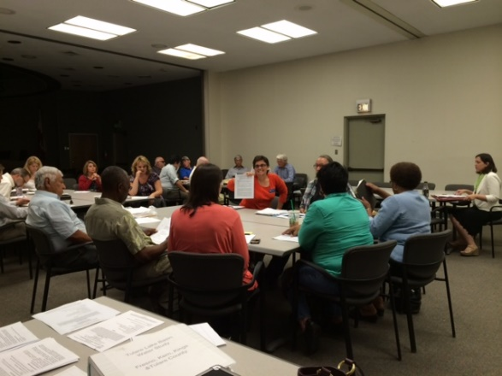

Ongoing Program Tasks
PAC Meetings
IRWM Meetings
Reporting

Slide 12
Available Budget for 2020
Remaining Unallocated Budget for Phase 2 : $133,790
Remaining Balance from Previously Approved Budget : $243,818
Grand Total : $377,608

Slide 13
Phase 2 Proposed Additional Program Activities and Budget
Utilize Available Unallocated Budget: $133,790 to Amend Nine (9)
Phase 1 Tasks and Add Task: 10
Proposed Budget Approval Request
  $70,000 for Project Development
  $31,470 for New Task – Task 10: TKFA Activities
  $144,784 for Amendments (Activities and Fiscal) to the following tasks:
    Task 1: Assessment of Past or Present DAC Engagement - $43,636
    Task 2: Community Water Needs Assessment - $29,419
    Task 3: Community Outreach & Education - $15,618
    Task 4: Coordination with Project Advisory Committee - $5,369
    Task 5: Program Administration - $4,217
    Task 6: Develop Individual DAC Engagement & Outreach Recommendations for IRWM Regions - ($264)
    Task 7: Develop IRWM Participation Recommendations for DACs & SDACs that are outside an IRWM region - $5,293
    Task 8: Provide Technical Assistance/Assist DACs to Prepare Funding Applications - ($42,978)
    Task 9: Conduct Pre-application and Grant Application Workshops/ Trainings - $9,762

Slide 14
Reasons for Requested Changes
Continue to Implement Phase 1 Tasks
  Longer/more involved process to allocate Project Development Funding
  SGMA triggered delays
Implement New Task/Activities
  Task 10: In response to feedback provided during meetings with each IRWM Region
  Tribal Outreach and Engagement (Civic Spark)
Continue Successes of Phase 1
  Project Development Funding
Budget Modifications due to annually adjusted SHE charge rates and lack of continuing Intern support and other volunteer staff

Slide 15
New Proposed Program Milestones
January 2020
Formal Phase 2 Proposal to PAC
March 2020
Final DAC Outreach and Engagement Recommendations Report
February – September 2020
Interim Deliverables &/or Status Updates
September 2020
Final DAC Engagement & Education Program Deliverables

Slide 16
Summary
If approved, the intent of the proposed 2020 Community Engagement Tasks will strengthen participation by representatives of DACs in the IRWM process and broaden the base of parties engaged in that process.
Outreach will be made to identify eligible DAC and/or Tribal projects that can be added to IRWM project lists, prepare Project Information Forms and then assist in preparing documents to allow DACs/Tribes to compete at the IRWM level to better qualify for funding at the State level.

Slide 17
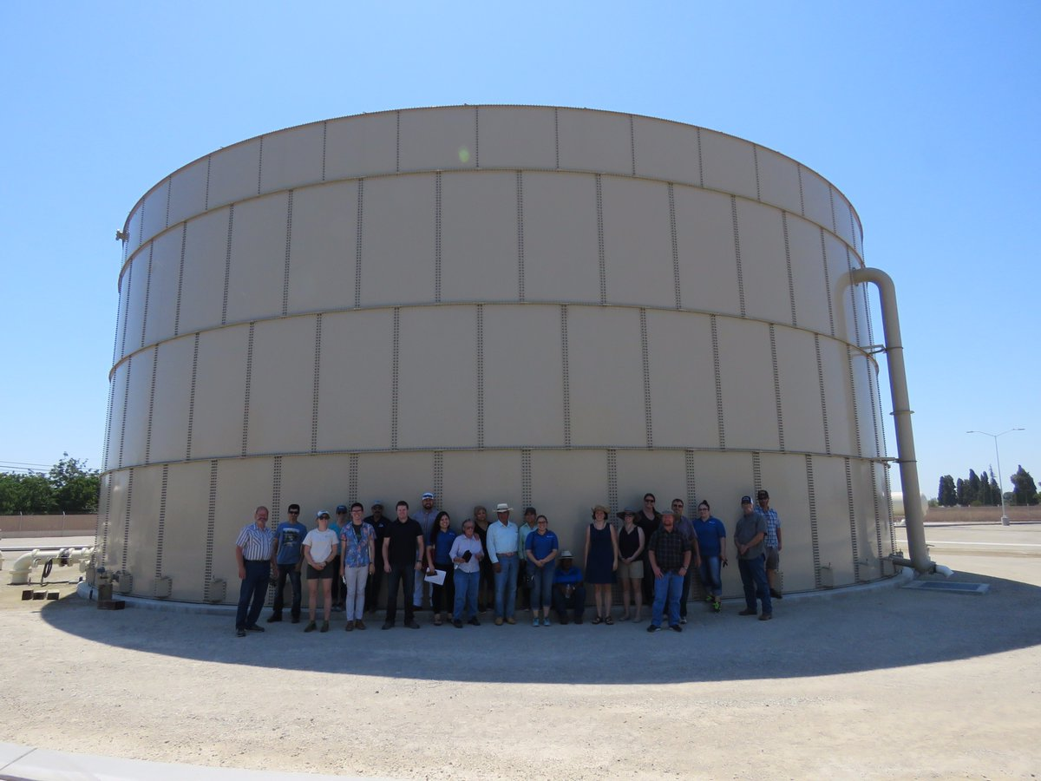
Questions/Thank You!

Slide 18
BUDGET DETAILS

Slide 19
Phase One and Phase One Amendment Approved Budget
Phase One and Phase One Amendment Approved Budget
1 | Assessment of Past or Present DAC Engagement | $ 46,650
2 | Community Water Needs Assessment | $ 76,300
3 | Community Outreach and Education | $149,100
4 | Coordination with Project Advisory Committee | $ 15,300
5 | Program Administration | $21,900
6 | Develop Individual DAC Engagement and Outreach Recommendations for IRWM Regions | $ 11,400
7 | Develop IRWM Participation Recommendations for DACs and SDACs that are outside an IRWM region | $ 18,330
8 | Provide Technical Assistance/Assist DACs to Prepare Funding Applications | $ 59,330
9 | Conduct Pre-Application and Grant Application Workshops or Trainings | $ 17,900
Total: |  | $416,210
Total DACEEP Allocated Budget: |  | $550,000
Remaining DACEEP Budget for Phase Two: |  | $133,790

Slide 20
Combined Scope of Work and Budget for 2020
January 2020 Proposed Budget Adjustments
Task |  | Approved Budget | Est Charges to Date (12/31/19) | 2020 Total Amount
Proposed Revisions to Existing Tasks
1 | Assessment of Past or Present DAC Engagement | $ 46,650 | $42,816 | $3,014
2 | Community Water Needs Assessment | $ 76,300 | $23,841 | $46,881
3 | Community Outreach and Education | $149,100 | $34,096 | $133,482
3.1 | Community Outreach and Tribal Engagement Plan (NEW) | $19,389
3.2 | Regional Community Meetings - Tribal Consultation (NEW) | $37,398
3.3 | Funding Area Educational Materials and Educational Videos Series (EXISTING) | $42,387
3.4 | Educational Water Tours (NEW) | $19,515
3.5 | TKDACI Roadshow (2 meetings in each County) (NEW) | $16,596
4 | Coordination with Project Advisory Committee | $ 15,300 | $6,562 | $9,931
5 | Program Administration | $21,900 | $12,946 | $17,683

Slide 21
Combined Scope of Work and Budget for 2020 (Continued)
January 2020 Proposed Budget Adjustments (CONTINUED)
Task |  | Approved Budget | Est Charges to Date (12/31/19) | 2020 Total Amount
6 | Develop Individual DAC Engagement and Outreach Recommendations for IRWM Regions | $ 11,400 | $0 | $11,664
7 | Develop IRWM Participation Recommendations for DACs and SDACs that are outside an IRWM region | $ 18,330 | $5,139 | $13,037
8 | Provide Technical Assistance/Assist DACs to Prepare Funding Applications | $ 59,330 | $29,691 | $102,308
8.1 | Complete project information forms/getting their project(s) on an IRWM list (EXISTING) | $22,770
8.2 | Attend IRWM Meetings/Tulare Basin IRWM coordination meetings (EXISTING) | $5,369
8.3 | Project Development - Implementation Funding Application Costs (EXISTING) | $74,168

Slide 22
Combined Scope of Work and Budget for 2020 (Continued)
January 2020 Proposed Budget Adjustments (CONTINUED)
Task |  | Approved Budget | Est Charges to Date (12/31/19) | 2020 Total Amount
9 | Conduct Pre-Application and Grant Application Workshops or Trainings | $ 17,900 | $13,204 | $8,138
New Proposed Task
10 | TKFA IRWM Activities |  |  | $31,470
Proposed 2020 Budget Subtotal: |  | $377,607
Total Allocated Budget: |  | $550,000
Phase 1 and Phase 1 Amendment Approved Budget: |  | $416,210
Estimated Phase 1 and Phase 1 Amendment Expenditures to date as of 12/31/2019: |  | $172,392
Phase 1 and Phase 1 Amendment Remaining Balance (12/31/2019): |  | $243,818
Remaining Unallocated Budget for Phase Two: |  | $133,790
Total Budget Available for 2020 |  | $377,608

